Slide 1
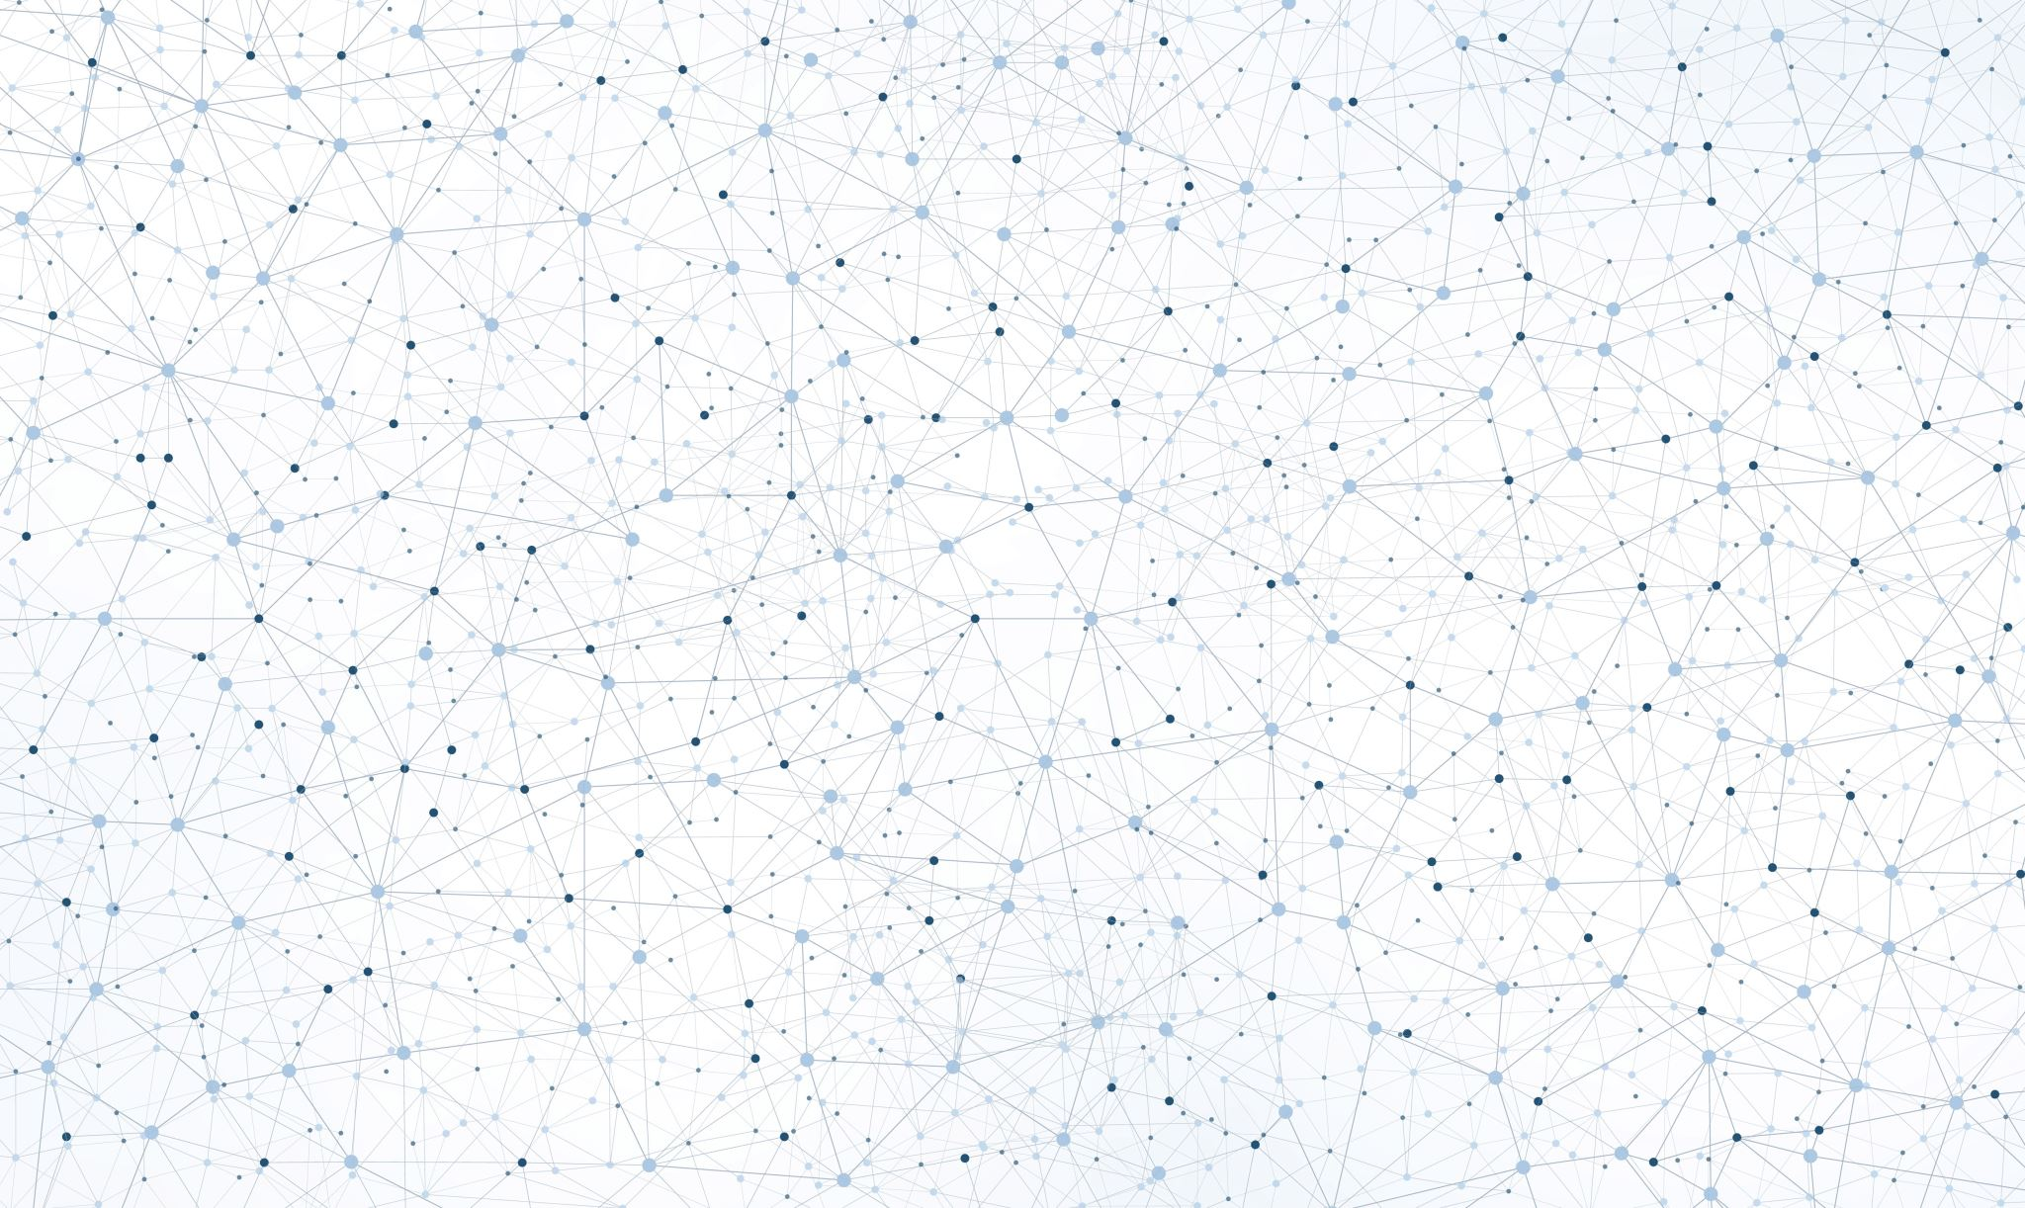

Mākslīgā intelekta risinājumi ražošanas procesu uzlabošanai - datorredze
2024
Valdis Saulespurens

Slide 2
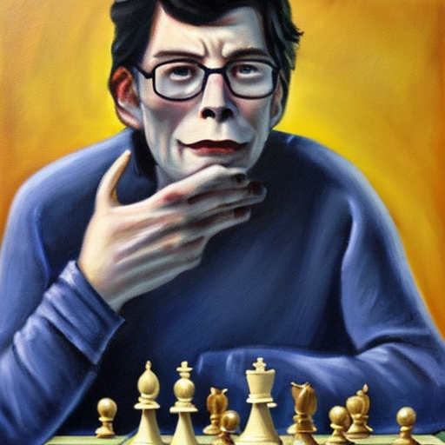
About Me
Valdis Saulespurens
30+ Years programming
Run retail and e-commerce store in 90s California
Lector RTU RBS
Researcher National Library of Latvia – OCR model improvement
valdis.saulespurens@rtu.lv

Slide 3
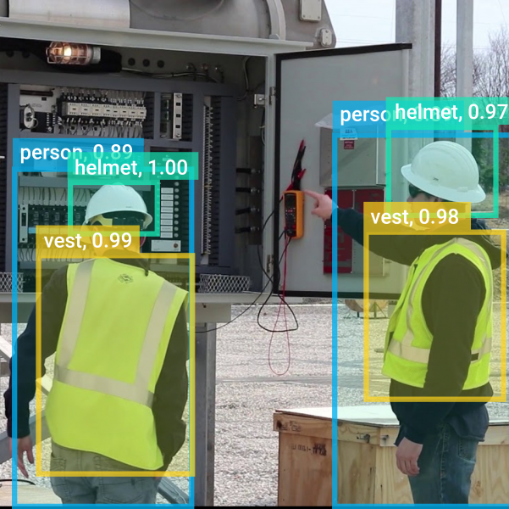
Datorredze – Computer Vision
Definition: A field of artificial intelligence(AI) that enables computers to interpret, analyze, and make decisions based on visual data from the real world, such as images and videos.
Involves techniques for processing, understanding, and extracting meaningful information from visual inputs to automate tasks that typically require human vision.

Slide 4
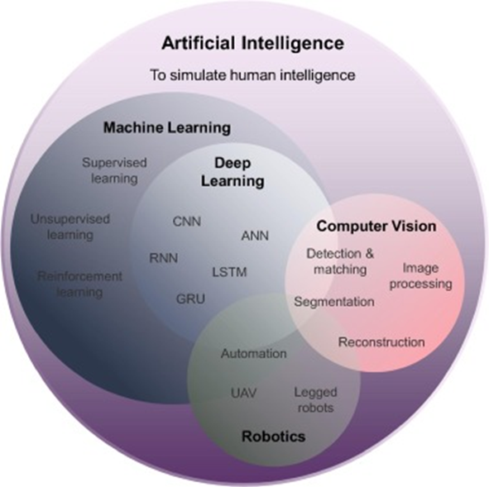

Computer Vision within AI field
Artificial Intelligence (AI) - Simulation of human intelligence in machines.
Machine Learning (ML) - Subfield of AI focused on algorithms that learn from data.
Deep Learning (DL) - Subfield of ML using neural networks with multiple layers.
Robotics - Design, construction, and operation of robots.
Machine Vision - Technology enabling machines to interpret and process visual information. Primarily used in industrial and manufacturing settings.
Img: https://medium.com/@su3230/computer-vision-cv-d204f81a9063

Slide 5
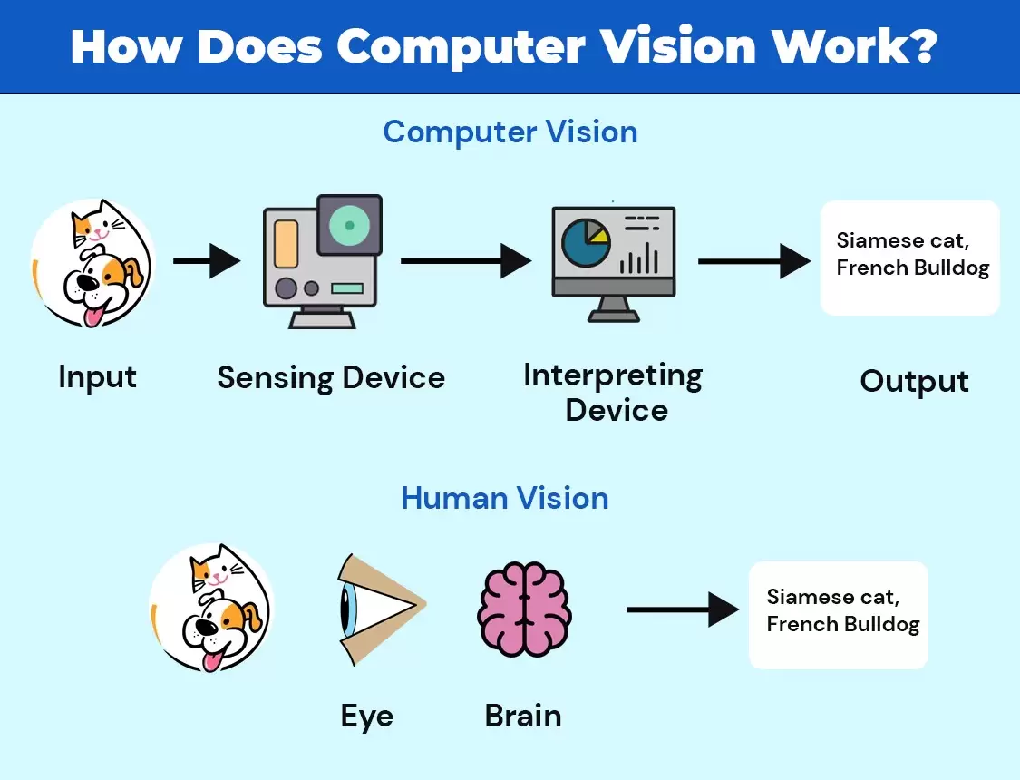
Input
Visual data such as images or videos.
Acquired from real-world environments.
Examples: photographs, live camera feeds, medical scans.
Sensing Device
Hardware capturing visual data.
Converts real-world scenes into digital images.
Examples: cameras, sensors, scanners.
Interpreting Device
Software or algorithms processing visual data.
Extracts meaningful information from images.
Examples: feature extraction, object detection, image classification.
Output
Processed results or actionable insights.
Can be in various forms such as visualizations, decisions, or commands.
Examples: labeled images, detected objects, autonomous vehicle navigation.

Slide 6
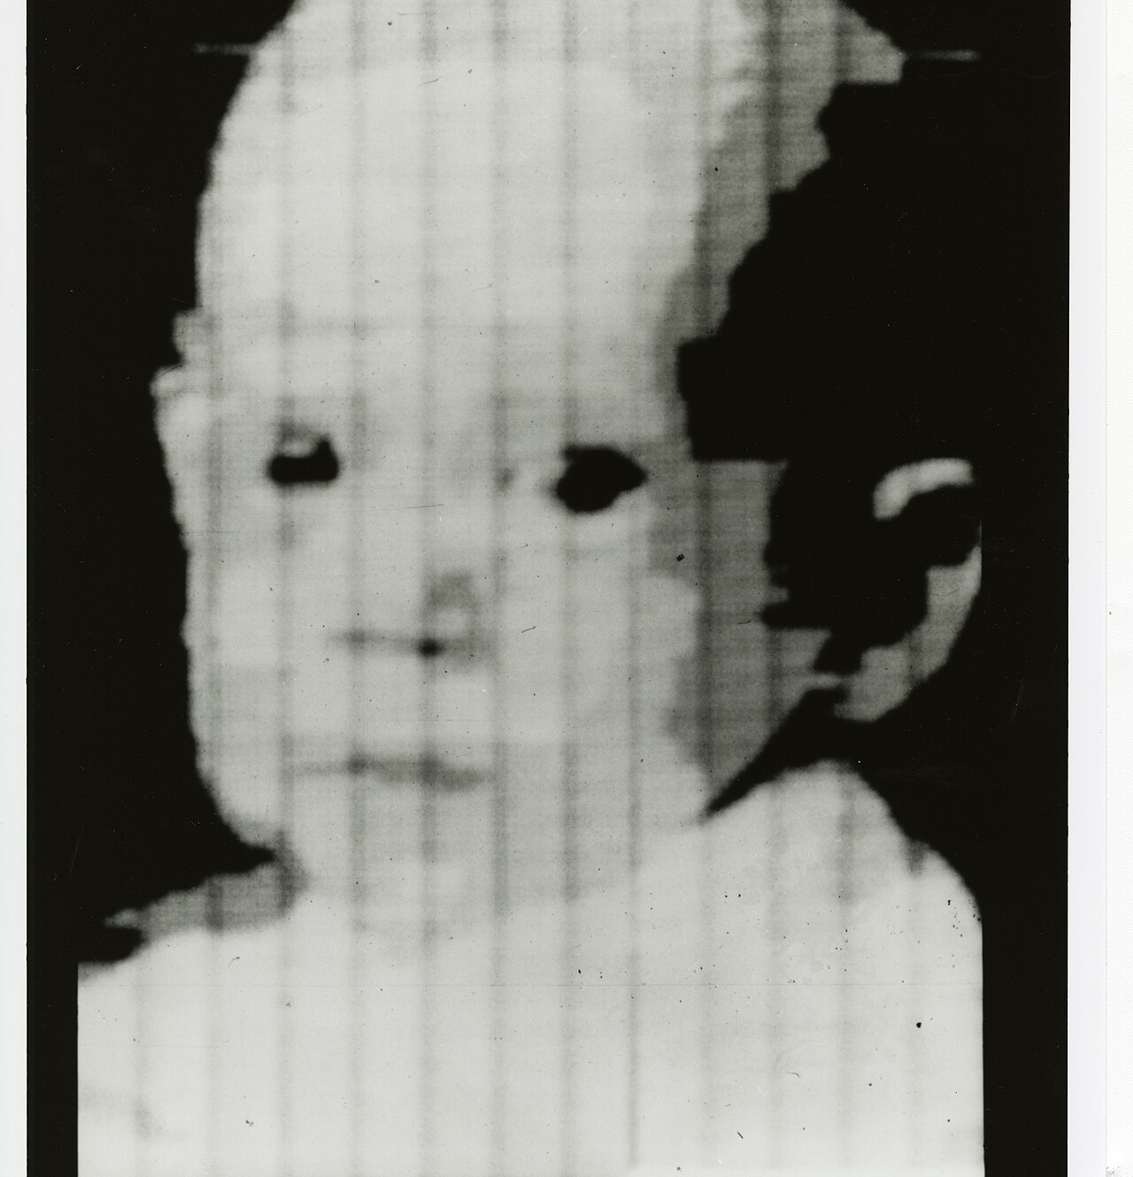
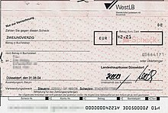
Early History of Computer Vision (1950s to 1970s)
First Scanned Image(NIST 1957) – Russell A. Kirsch, others
1957 – D.H. Hubel and Wiesel – how do cats see? Neural basis of vision, simple and complex cells. (Nobel 1981)
1966 – Marvin Minsky (MIT) – Summer of Computer Vision – Block World
1970s – Early OCR (Optical Character Recognition) systems. – special fonts, still used in some fields such as bank checks
David Marr's Theory of Edge Detection (1976) – importance of edges

Slide 7
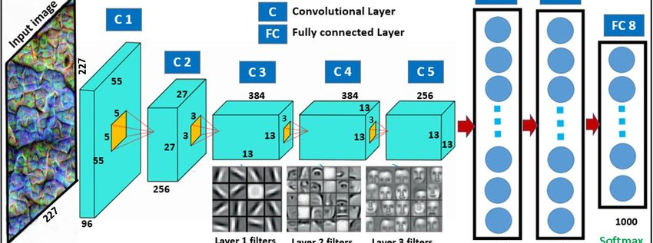
1980s to 2012
1980s – Feature-Based Models (edges,corners, textures)
1990s – Early Experiments with Neural Networks and Deep Learning, backpropagation, 3D vision, advances in Face Recognition
2000s – Boosting Algorithms, Large Scale Image Datasets
2012 – ImageNet dataset (big labeled dataset), GPU acceleration, AlexNet top accuracy in the ImageNet Large Scale Visual Recognition Challenge (ILSVRC) 2012, bringing Convolutional Neural Network (CNN) Architecture to forefront

Slide 8

2012-Onwards
Deeper Networks VGG(2013) Oxford, GoogleNet/Inception(2014), ResNet(2015)-Microsoft
YOLO (You Only Look Once) Series (2016 onwards)
Transformers in Vision (2017 onwards) – attention based models
DALL-E and Generative Models (2021), Stable Diffussion, Midjourney, advances in GAN(Generative Adversarial Networks)
Edge AI and On-Device Learning - complex vision models on edge devices like smartphones and IoT devices.

Slide 9
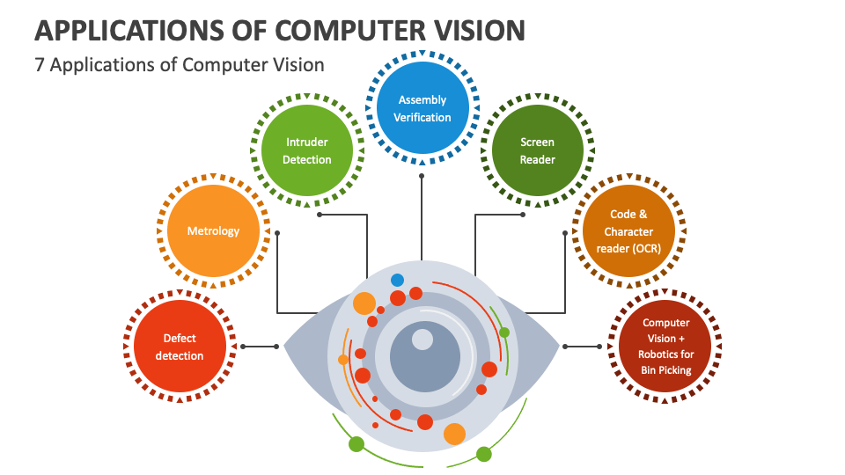
Subfields of Computer Vision
Image Classification
Face Recognition
Optical Character Recognition (OCR)
Object Detection
Image Segmentation
Activity Recognition
3D Vision
Scene Understanding

Slide 10
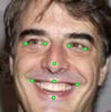
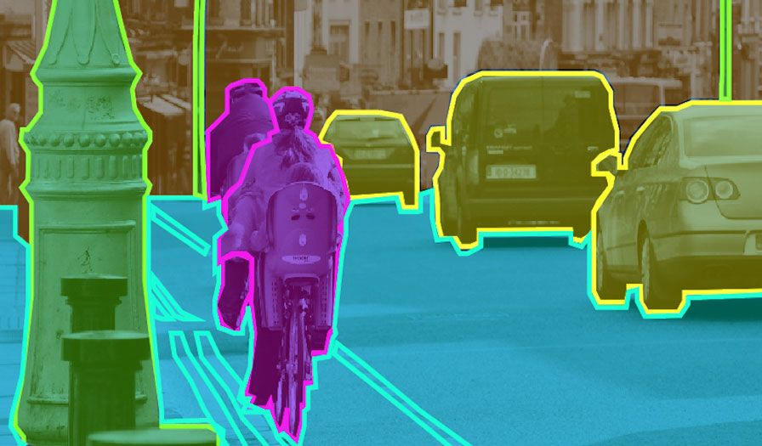
Image Segmentation
Segmentation – Object Detection
Localization – Important Points
Define Your Goals
Gather and Prepare Data
Preprocess Your Images
Select a Segmentation Method (U-Net, Mask R-CNN others)
Build and Train Your Segmentation Model
Evaluate the Model
Refine, Deploy, Monitor and Improve

Slide 11
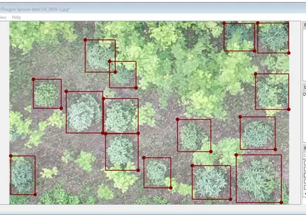
Image Classification
Define the Problem – what am I trying to classify
Collect and Prepare Data
Preprocess the Data
Choose a Model Architecture
Build and Train the Model
Evaluate the Model on Test Set
Fine-tune and Optimize
Deploy the Model
Monitor and Maintain
Src: https://www.mdpi.com/2076-3417/13/2/895

Slide 12
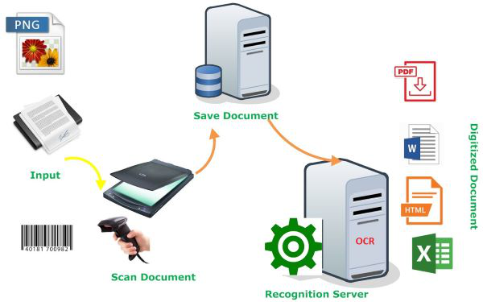
Optical Character Recognition
Similar steps to General Classifier
Well studied
Rules based OCR overtaken by LTSM and other neural net architectures
Business case for digitalization
Open Source models such as Tesseract can achieve excellent results by performing supplemental training to existing models

Slide 13
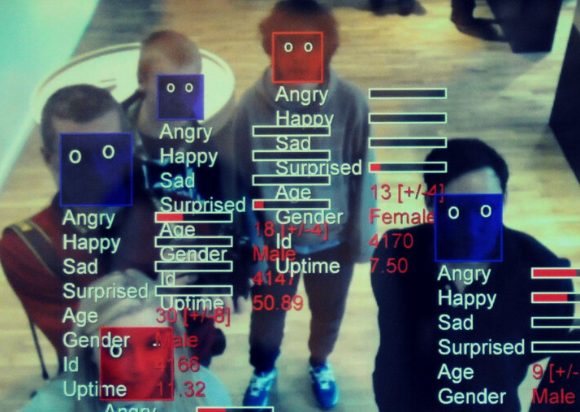
Face Recognition
Similar steps to General Classifier
Well studied
Privay and Ethics Concerns
EU - GDPR

Slide 14
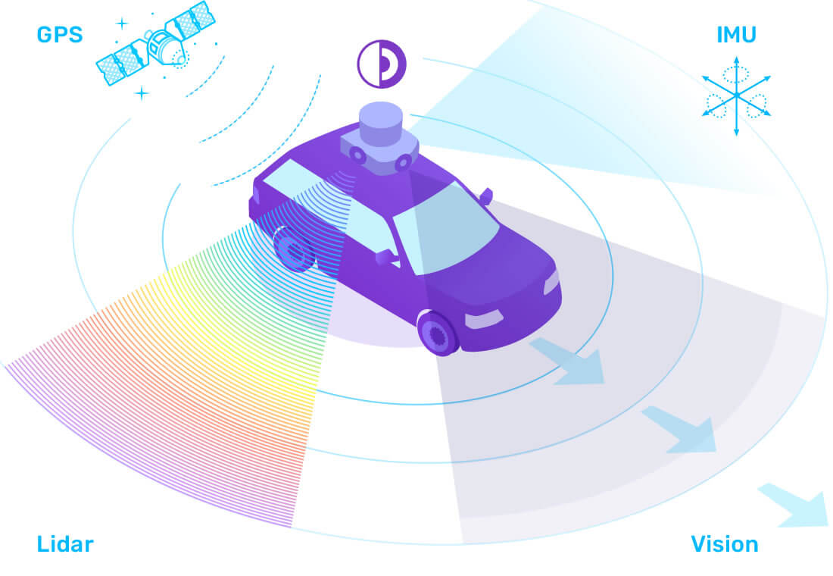
Simultaneous Localization and Mapping(SLAM)
Localization: Determining the precise position and orientation of the observer within the environment.
Mapping: Creating a representation (map) of the environment based on sensor data.
Computer Vision part of SLAM

Slide 15
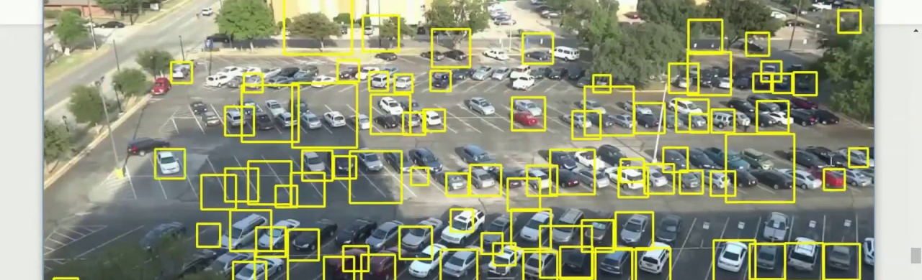
Real-Time Video Processing in Computer Vision
Real-time video processing involves analyzing and interpreting video data on-the-fly, enabling immediate decision-making and actions based on the visual input.
Frame-by-Frame Analysis
Temporal Information Utilization – using multiple frames
Applications in Security, Analytics, Autonomous Vehicles
Src: https://www.youtube.com/watch?v=y1M5dNkvCJc

Slide 16
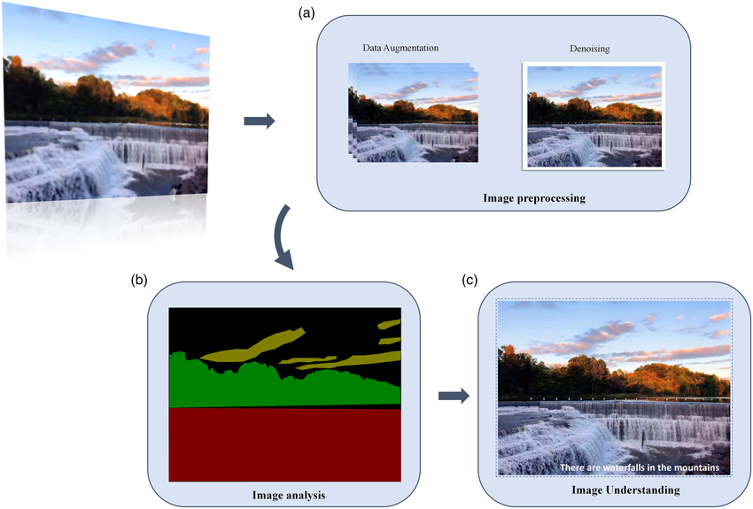
Preprocessing Pipeline Clean and Normalized Data is of Essence!
Normalize: color, size
Localize & crop
Convert to intensity, normalize
For Video might need to think about framerate

Slide 17


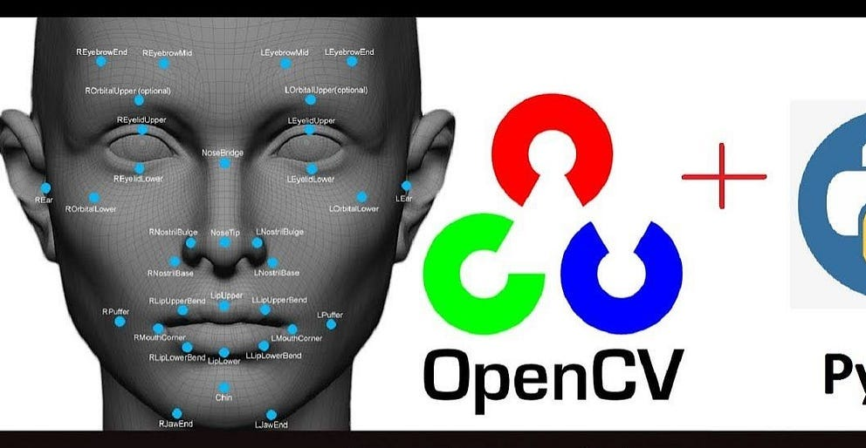
Resources to play around:
https://segment-anything.com/ - State of Art segmentation model developed by Meta
https://roboflow.com/ - For developing your own models and supplemental training of existing ones
https://chatgpt.com/ - Now supports integration with DallE, also does object detection with OCR support
https://gemini.google.com/ - playing catchup
https://www.heygen.com/ - VIDEO PRODUCER AI – expensive
https://opencv.org/ - Open Computer Vision library, integrates with various languages, tooling

Slide 18
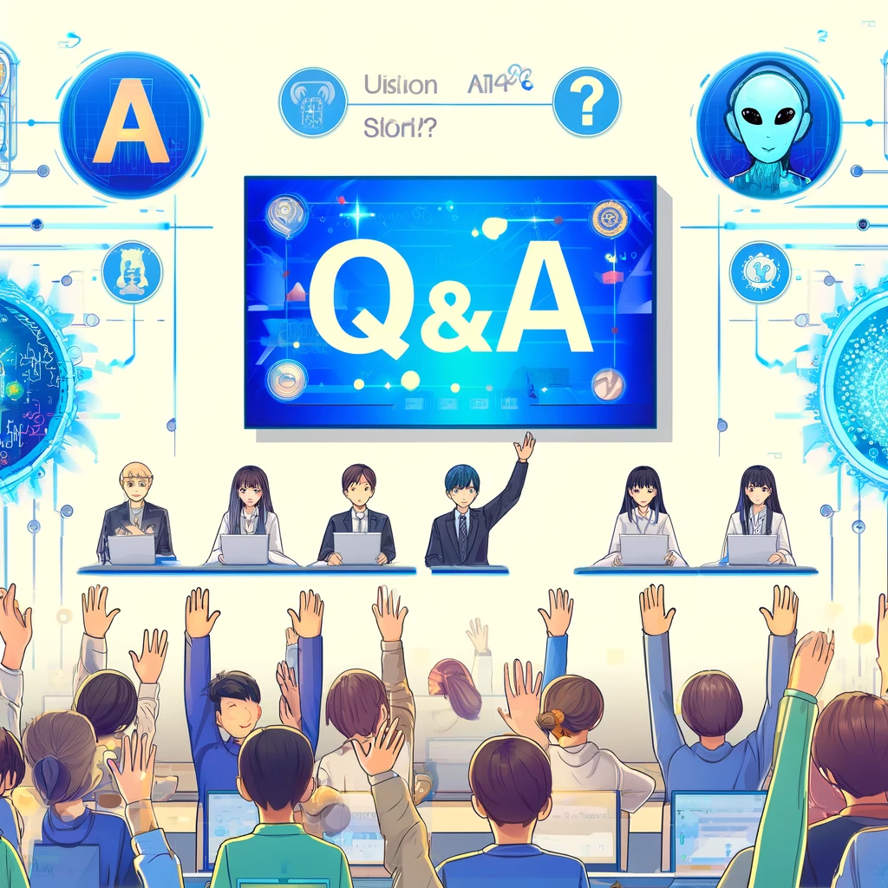
Conclusion: CV goes along with other AI disciplines
Questions
Thank You!
https://github.com/ValRCS/AI_Studio_24

